Slide 1

Exchange store
Kuzey Arda Bulut Cybersecurity
Tallinn University of Technology
26.09.2025

Slide 2
Problem Statement & Scope
Problem Statement: Customers often face confusion when converting currencies due to unclear exchange rates and inconsistent denomination handling. Manual tracking of reserves and profits is error-prone. Administrators lack accurate reports to evaluate daily performance.
Scope:
System allows customers to exchange between supported currencies
Balances and reserves are updated in real-time after each transaction
Receipts are generated for customers and daily reports for management
Cashiers can view exchange rates and manage reserves
(Excluded: internet-based real-time rate updates, mobile app integration, multi-branch synchronization)

Slide 3
User Stories
As a customer, I want to see the current exchange rates so that I can decide quickly whether to proceed with a transaction.
Acceptance Criteria: Exchange rates are displayed immediately upon request and match the system’s stored values.
As a customer, I want the system to prevent an exchange when reserves are insufficient so that I don’t waste time.
Acceptance Criteria: System shows “Insufficient Reserves” if the requested payout cannot be fulfilled.
As a cashier, I want balances and reserves to update instantly after each transaction so that I always have accurate availability.
Acceptance Criteria: Reserve values match internal data after each exchange, tested with 10+ transactions.

Slide 4
User Stories
As a manager, I want the system to log all transactions so that I can generate accurate reports.
Acceptance Criteria: Each transaction is saved in a CSV file with timestamp, currency type, and exchanged amount.
As a manager, I want a daily summary report so that I can analyze overall performance.
Acceptance Criteria: Report includes total number of exchanges, per-currency balances, and daily profit.
As a cashier, I want the system to provide denomination breakdowns so that I can pay customers using the correct mix of notes. Acceptance Criteria: System suggests a valid combination of denominations for every payout, ensuring no fractional notes are included.

Slide 5
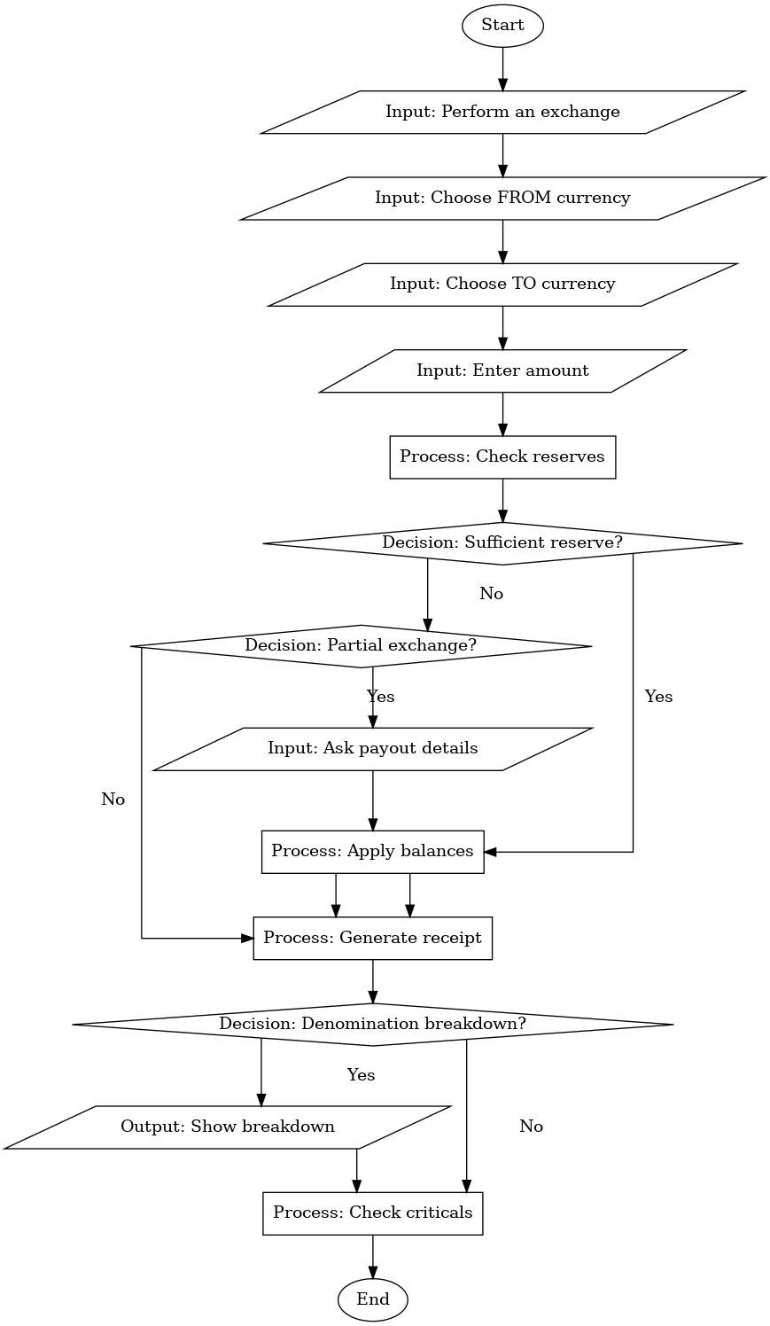
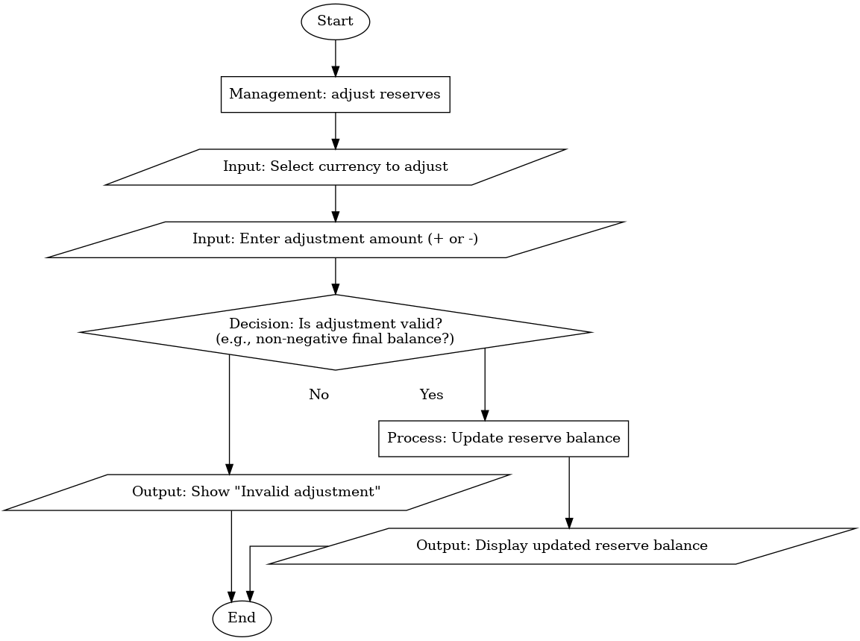
Flowchart

Slide 6
Traceability Table
User Story | Flowchart | C Element | Acceptance Criteria
As a client, I want to convert currencies so I can simulate my trades. | Flowchart 1 — Exchange Operation | scenario_exchange() | 100 EUR → USD → 116.54 USD -5 → Error: invalid amount TL → SEK→ Error: unknown currency
As a cashier, I want the program to show an error if the amount is not valid. | Flowchart 1 — Exchange Operation | ask_double(), ask_int() | -10000000000000 → Error: invalid amount
As a manager, I want to manage reserves. | Flowchart 2 — Balance Adjustment | scenario_manage_reserves() | Input 100 for BUY -> Input 50 for SELL; Error(Invalid input SELL ≥ BUY)

Slide 7
Team Roles
Kuzey Arda Bulut – Coding, reporting and presentation

Slide 8
Lessons Learned
Working Solo
Learning about Traceability Table
Making a presentation
C Coding

Slide 9
QUESTIONS???

Slide 10

THANKS FOR lISTENING!!
KUZEY aRDA bULUT
git@github.com:kuzeyardabulut/ICS0004.git
@kuzeyardabulut

